Slide 1
Name: Haseeb Shahzad
Roll No: 5121202
Class: BS Data Analytics
Semester: 5th
Subject: Data Warehouse
Project: Google Play Store Analysis
Teacher: Mam Rabia Shahid

Slide 2
Project: Dashboard for Google Play Store Analysis

Slide 3
Agenda:
Introduction
Total Apps
Average Rating
Total Revenue
Total Revenue by Months
Total Install
Total Install by Months
Total Reviews
Total Reviews by Types
Sentiment Analysis

Slide 4
Project Overview
An analysis and visualization of google play store apps scraped data for the period of 2010 - 2018 . This project aims at cleaning the dataset, analyzing the given dataset, and mining informational quality insights. This project also involves visualizing the data to better and easily understand trends and different categories.

Slide 5
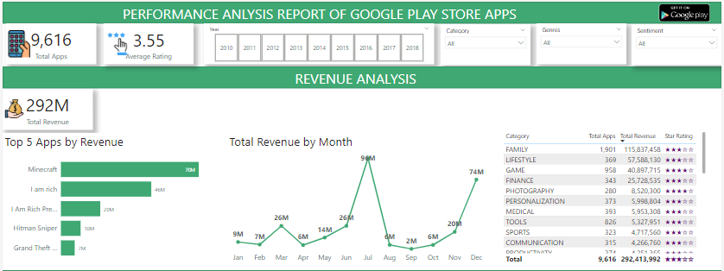
Overall Project View

Slide 6
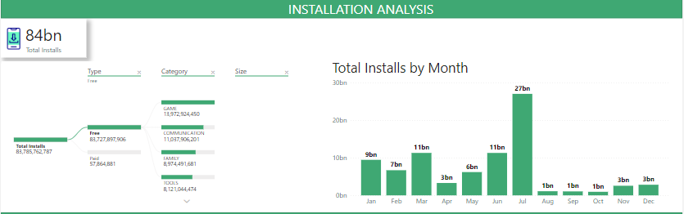

Slide 7
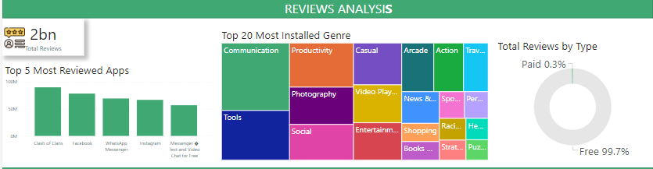

Slide 8
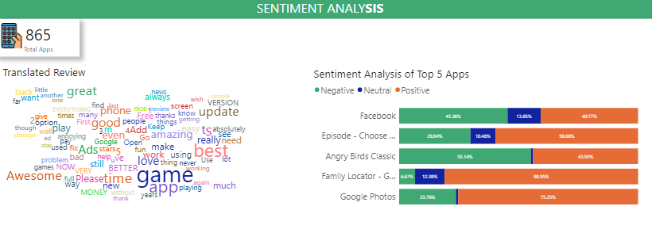

Slide 9

Total Apps
This presentation provides an in-depth analysis google play store apps. Through this comprehensive review, we will gain valuable insights into their impressive performance and key highlights.

Slide 10

Average Rating
Rating for google play store till year 2010 to 2018

Slide 11

Total Revenue

Slide 12
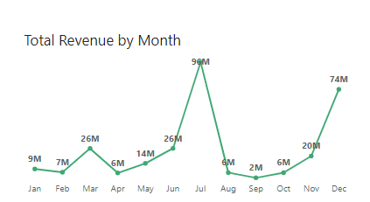
Total Revenue by Month

Slide 13
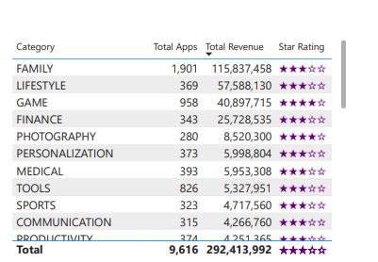
Category and Rating Table

Slide 14

Total Install Apps

Slide 15
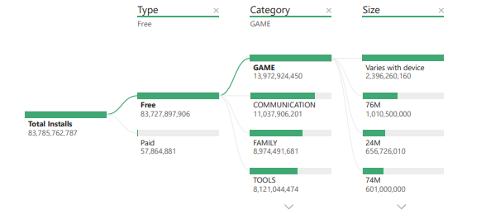
Total Installs By Types

Slide 16
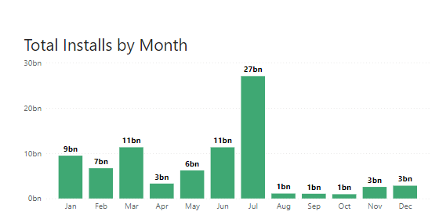
Total Installs by Months

Slide 17

Total Reviews

Slide 18
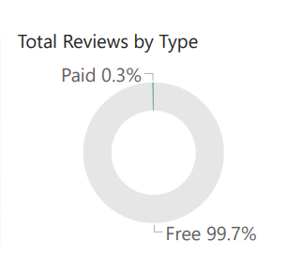
Total Reviews by Type

Slide 19

Sentiment Analysis total Apps

Slide 20
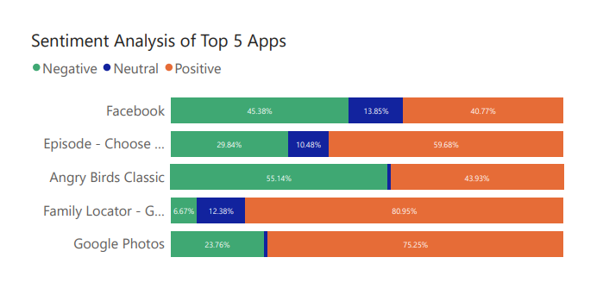
Sentiment Analysis of top 5 Apps

Slide 21
Thank You

